Slide 1

File Data Security Using Elliptic Curve Cryptography
by
B. Suvarchala
Roll No. 214G1A32A9
K. Yugandhar
Roll No. 224G5A3215
B. Rohini
Roll No. 214G1A3287
B. Swaroopa
Roll No. 214G1A32B1
Under the guidance of
Mr. K. Venkatesh _{M. Tech.,(Ph.D)}
Assistant Professor
GitHub Link: https://github.com/BhupalamSwaroopa/CSD-2024-25-Batch-B-01
Department of Computer Science and Engineering
Srinivasa Ramanujan Institute of Technology
(Affiliated to JNTUA & Approved by AICTE) (Accredited by NAAC with ‘A’ Grade & Accredited by NBA (EEE, ECE & CSE)
Rotarypuram Village, B K Samudram Mandal, Ananthapuramu – 515701.
2024 - 2025

Slide 2
Abstract
Encryption ensures secure communication over unprotected channels by preventing unauthorized access and data manipulation. Symmetric encryption, known for its large key size, is widely used for key exchange but faces challenges in cloud security due to computational overhead. However, due to large key size asymmetric encryption is mostly used for Key exchange rather than data Encryption. Nowadays, Data security is the main issue in large data centres and Cloud computing. This paper uses Elliptic Curve Cryptography with hybrid mechanism to encrypt data in the cloud environment because the size of the key used in Elliptic Curve Cryptography is very small. Due to the small key size of Elliptic Curve, computational power is reduced and this results into least energy consumption. This paper shows that elliptic curve cryptography is fast and more efficient for data protection in a cloud computing environment and reduces the computational power and also increases the efficiency.
KEYWORDS: Elliptic Curve Cryptography (ECC), Cloud Computing, Data security.

Slide 3

Contents
Introduction
Literature Survey
Existing System
Proposed System
Objectives
Requirements (functional and nonfunctional)
System Architecture
UML/ER Diagrams
Implementation
Results (Screenshots)
Conclusion
References
Paper submission proof

Slide 4
Introduction
In today’s rapidly evolving digital landscape, the security of sensitive data has become a critical challenge, particularly in cloud computing environments where vast amounts of information are continuously stored and transmitted. As organizations increasingly rely on cloud services for data management, the need for robust and efficient encryption techniques is paramount.
Traditional encryption methods, such as RSA, though highly secure, often involve large key sizes, which lead to significant computational overhead and energy consumption.
Elliptic Curve Cryptography (ECC) has emerged as a highly effective alternative to traditional encryption methods. ECC offers the same level of security as other public-key cryptosystems but with much smaller key sizes. ECC's ability to provide robust security with minimal resource usage makes it an attractive option for modern data security challenges.

Slide 5
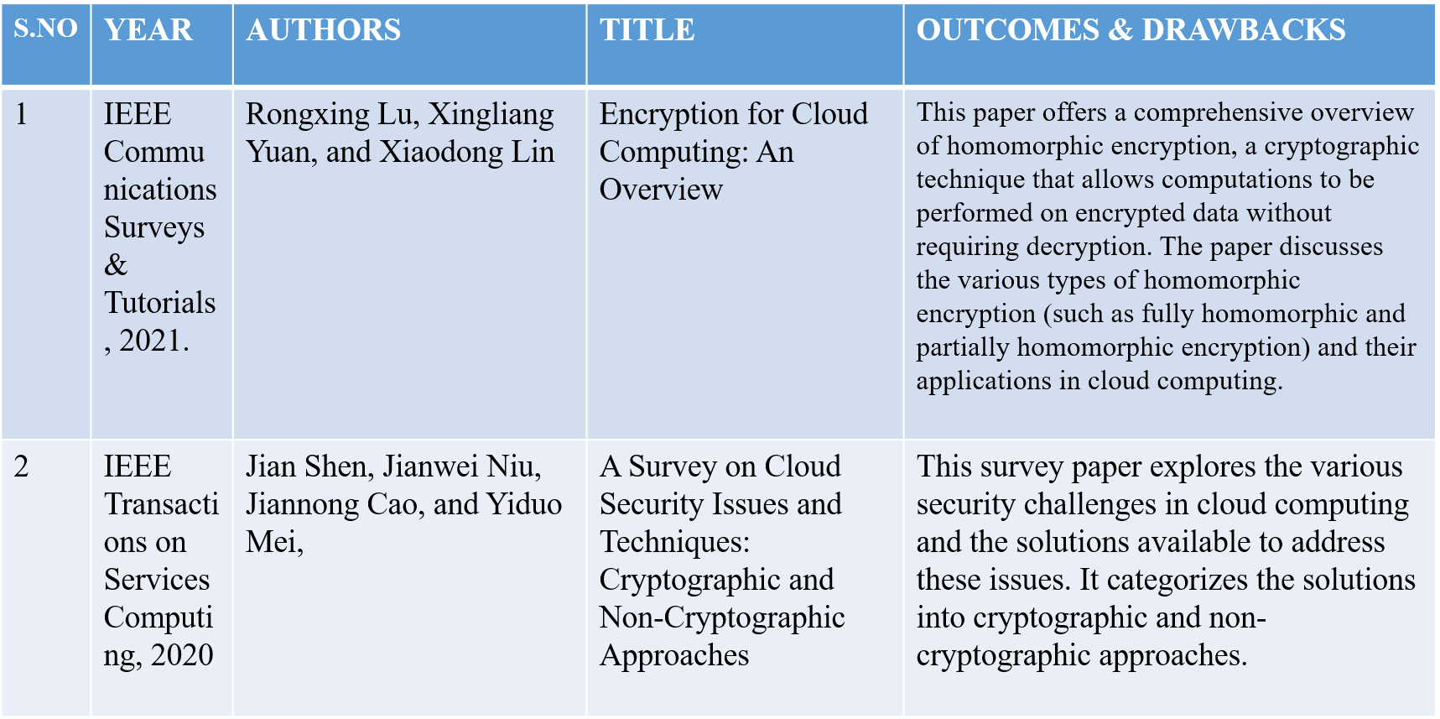
Literature Survey

Slide 6
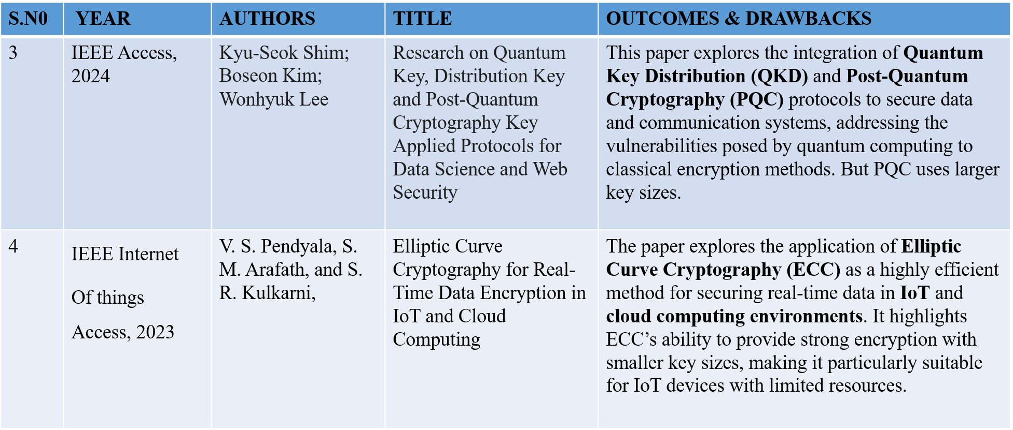
Cont…

Slide 7
Existing System
The existing system for data security in cloud computing primarily relies on traditional encryption techniques like RSA and AES.
They often require large key sizes, leading to significant computational overhead and increased energy consumption.
This is particularly problematic in large-scale cloud environments, where efficiency and scalability are critical.

Slide 8
Proposed System
The proposed system integrates Elliptic Curve Cryptography (ECC), providing enhanced security with smaller key sizes compared to RSA, resulting in faster encryption and decryption processes.
The system includes automatic audit log updates to enhance traceability and maintain system integrity, offering a scalable, efficient, and secure cloud storage framework for optimal data security and retrieval performance.
The integration of ECC with Quantum Key Distribution (QKD) improves the scalability of cloud systems, enabling them to handle larger datasets more efficiently while maintaining robust security standards.

Slide 9
Objective Of Project
The objective of this project is to enhance data security in cloud computing environments by implementing Elliptic Curve Cryptography (ECC).
The project aims to demonstrate ECC's ability to provide robust encryption with reduced computational power and energy consumption compared to traditional methods.
By optimizing the use of ECC for secure data transmission, this project seeks to contribute to the development of more efficient and secure cloud-based systems, ensuring the protection of sensitive information.

Slide 10
Requirements
Requirement’s analysis is very critical process that enables the success of a system or software project to be assessed. Requirements are generally split into two types: Functional and non-functional requirements.
Functional Requirements: These are the requirements that the end user specifically demands as basic facilities that the system should offer.
Data Owner – Register, Login, Upload files, View files, View file request, Logout.
Data User - Register, Login, View files, View response, Download file, Logout.
Cloud – Login, View and authorize Data owner, View and authorize Data user, Send key, Logout.
Non-functional requirements: These are basically the quality constraints that the system must satisfy according to the project contract. The priority or extent to which these factors are implemented varies from one project to other. It includes Performance, Scalability, Security, Availability, Compatability.

Slide 11
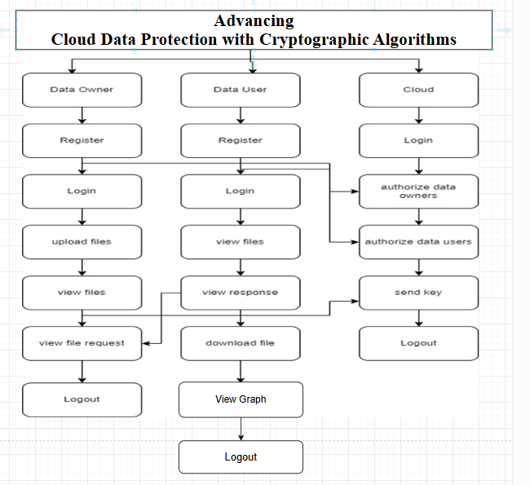
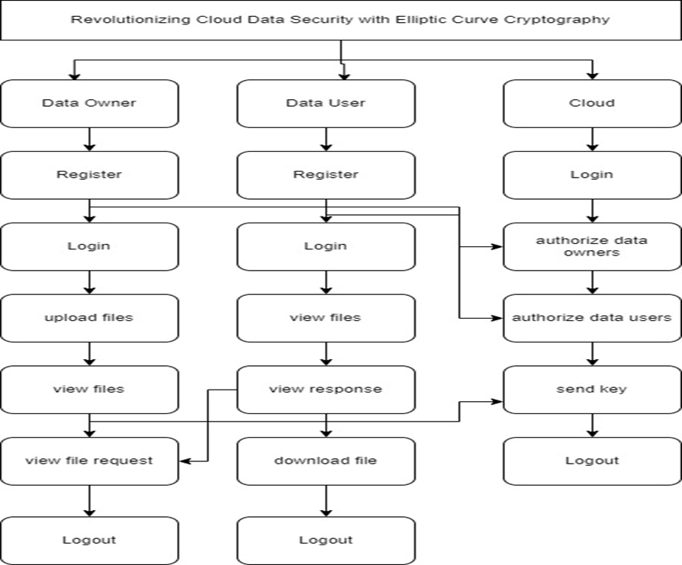
System Architecture
Figure: System Architecture

Slide 12
UML DIAGRAMS
Use Case Diagram:
A use case diagram in the Unified Modeling Language (UML) is a type of behavioral diagram defined by and created from a Use-case analysis. Its purpose is to present a graphical overview of the functionality provided by a system in terms of actors, their goals (represented as use cases), and any dependencies between those use cases. The main purpose of a use case diagram is to show what system functions are performed for which actor. Roles of the actors in the system can be depicted.

Slide 13
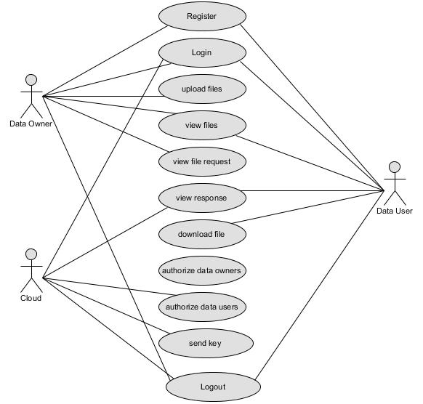
Cont…

Slide 14
ER Diagram
An Entity–relationship model (ER model) describes the structure of a database with the help of a diagram, which is known as Entity Relationship Diagram (ER Diagram). An ER model is a design or blueprint of a database that can later be implemented as a database. The main components of E-R model are: entity set and relationship set.
An ER diagram shows the relationship among entity sets. An entity set is a group of similar entities and these entities can have attributes. In terms of DBMS, an entity is a table or attribute of a table in database, so by showing relationship among tables and their attributes, ER diagram shows the complete logical structure of a database.

Slide 15
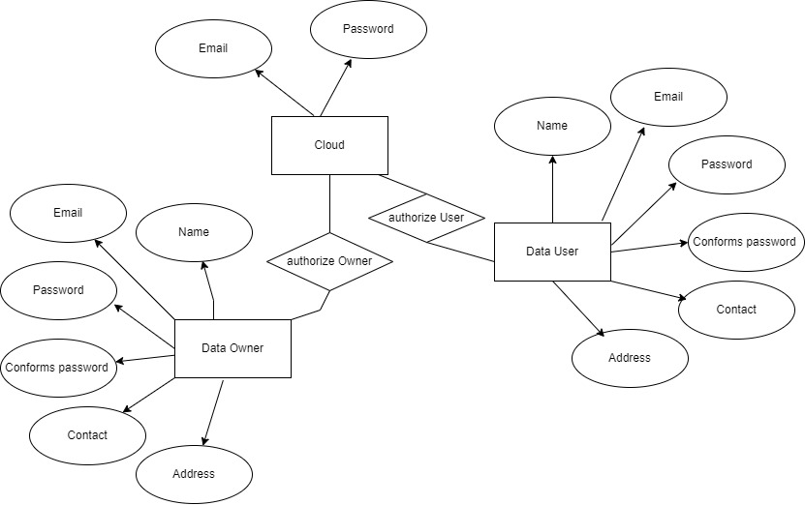
Cont…

Slide 16
Implementation
Quantum-Based Encryption in ECC Algorithm: As part of the encryption and decryption processes, this quantum-based encryption method puts to use the special capabilities of quantum computing in order to produce cryptographic keys as well as carry out encryption and decryption procedures.
Quantum Key Generation: The primary idea behind this algorithm is that it is based on the use of quantum circuits to create a random cryptographic key. There is a key operation in quantum computing known as the Hadamard gate, which is essentially a superposition of states for the qubit, resulting in a more randomized outcome.

Slide 17
Cont…
Text to Binary Conversion :
def text_to_binary_v3(text):
return ' '.join(format(byte, '08b') for byte in text.encode('utf-8’))
Encryption :
encrypted_data = ''.join(str(int(b) ^ int(k)) for b, k in zip(binary_text, key)
Decryption :
decrypted_binary = ''.join(str(int(b) ^ int(k)) for b, k in zip(encrypted_data, quantum_key))

Slide 18

Results
Home page: Revolutionizing Cloud Data Security with Elliptic Curve Cryptography home page.

Slide 19
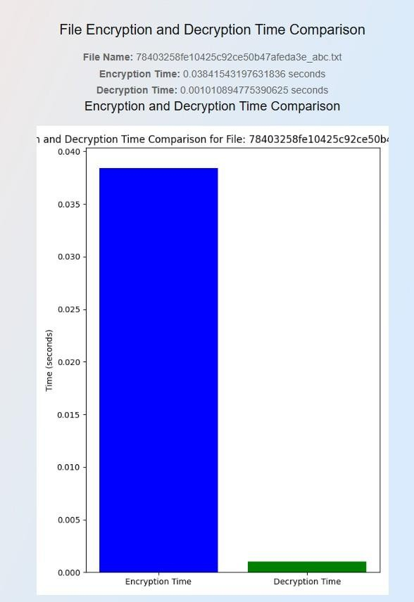
Cont…
Graph for AES : AES provides the fast and efficient symmetric encryption but also faces some challenges in key management and quantum vulnerabilities, making it suitable for short-term security. As it also includes a single key for encryption and decryption.

Slide 20
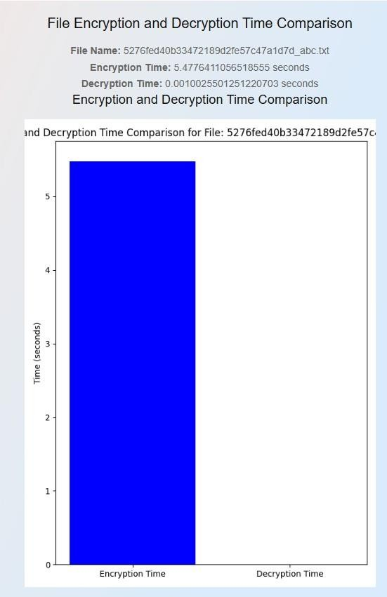
Cont…
Graph for ECC - Quantum : ECC with Quantum Cryptography provides the secure encryption, faster decryption, and reduced computational overhead. As it uses two keys for the encryption and decryption process.

Slide 21
Conclusion
The proposed system, leveraging Elliptic Curve Cryptography (ECC), addresses these challenges by offering strong encryption with significantly smaller key sizes, reducing computational overhead and energy consumption.
ECC's ability to deliver robust security while enhancing system performance makes it an ideal solution for modern cloud infrastructures and real-time applications.

Slide 22
References
[1]. R. Lu, X. Yuan, and X. Lin, "Homomorphic Encryption for Cloud Computing: An Overview," IEEE Communications Surveys & Tutorials, vol. 23, no. 4, pp. 2381-2405, 2021.
[2]. Kyu-Seok Shim; Boseon Kim; Wonhyuk Lee “Research on Quantum Key, Distribution Key and Post-Quantum Cryptography Key Applied Protocols for Data Science and Web Security “vol. 23, 2024
[3]. J. Shen, J. Niu, J. Cao, and Y. Mei, "A Survey on Cloud Security Issues and Techniques: Cryptographic and Non-Cryptographic Approaches," IEEE Transactions on Services Computing, vol. 13, no. 3, pp. 434-451, 2023.
[4]. M. S. Ali, K. K. R. Choo, and S. H. Ahmed, "Blockchain-Based Secure Data Storage and Access Control for Cloud Applications," IEEE Transactions on Cloud Computing, vol. 9, no. 3, pp. 1215-1226, 2021.
[5]. V. S. Pendyala, S. M. Arafath, and S. R. Kulkarni, "Elliptic Curve Cryptography for Real-Time Data Encryption in IoT and Cloud Computing," IEEE Internet of Things Journal, vol. 8, no. 5, pp. 3615-3623, 2021.
[6]. Dong Pan; Gui-Lu Long; Liuguo Yin; Yu-Bo Sheng; Dong Ruan; Soon Xin Ng; Jianhua Lu; Lajos Hanzo , ”The Evolution of Quantum Secure Direct Communication: On the Road to the Qinternet” Vol. 26 ,2024

Slide 23
Cont…
[7]. K. Khan and R. Qazi, "Data Security in Cloud Computing Using Elliptic Curve Cryptography," International Journal of Computing and Communication Networks, vol. 1, no. 1, pp. 46-52, 2022
[8]. V. S. Miller, "Use of Elliptic Curves in Cryptography," in Conference on the Theory and Application of Cryptographic Techniques, 2020, pp. 417-426.
[9]. M. -Q. Hong, P. -Y. Wang, and W. -B. Zhao, "Homomorphic Encryption Scheme Based on Elliptic Curve Cryptography for Privacy Protection of Cloud Computing," in IEEE 2nd International Conference on Big Data Security on Cloud (BigDataSecurity), High Performance and Smart Computing (HPSC), and Intelligent Data and Security (IDS), 2023, pp. 152-157.
[10]. A. Chhabra and S. Arora, "An Elliptic Curve Cryptography Based Encryption Scheme for Securing the Cloud Against Eavesdropping Attacks," in IEEE 3rd International Conference on Collaboration and Internet Computing (CIC), 2024, pp. 243-246.

Slide 24
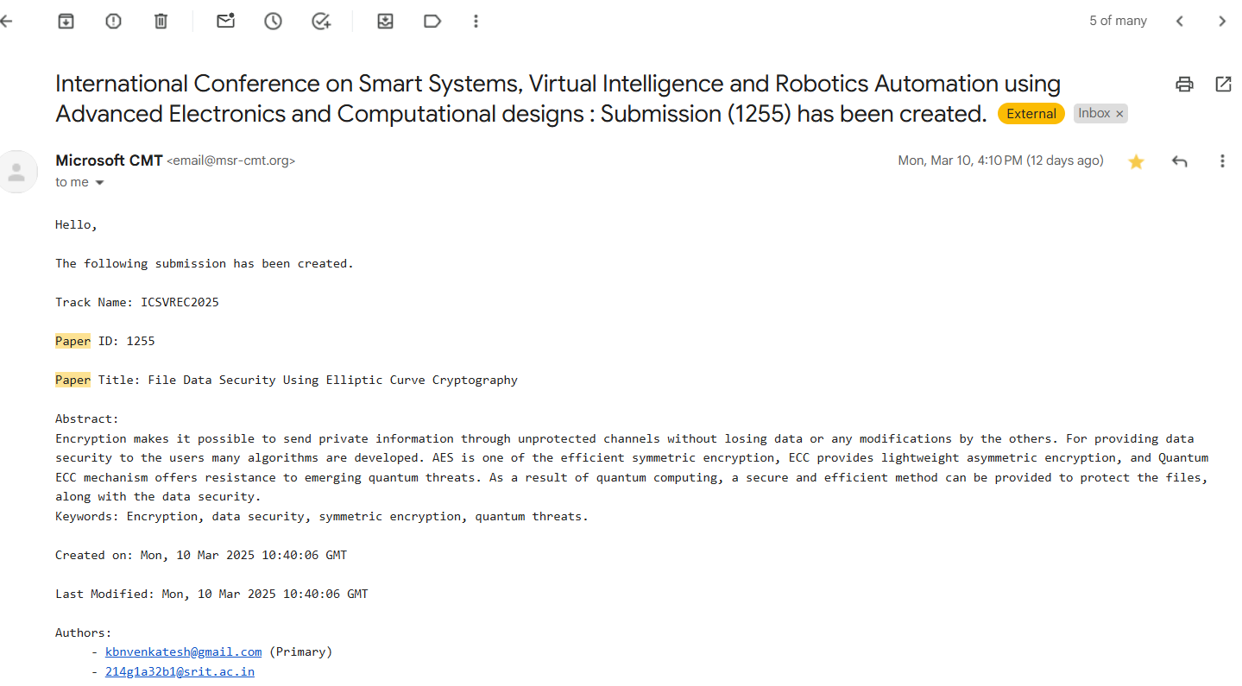
Paper submission proof
Paper Submitted

Slide 25
Thank You!!!

